Slide 1
Ruby Basic Training
Chao Yang
Feb, 13 2019

Slide 2


Ruby Introduction
Ruby is an object-oriented scripting language. It is open source and free.
Official website : https://www.ruby-lang.org
Ruby core reference ：http://ruby-doc.org/core-2.6.1/
PPT demo: https://github.com/jfyh5388/ruby_training
Install Ruby in Windows
Ruby installation package download page：https://rubyinstaller.org/downloads/
Select ‘Add Ruby executables to your PATH’ :
Enter 'ruby –v’ in ‘cmd’ and get the ruby version number to indicate that the installation was successful.

Slide 3
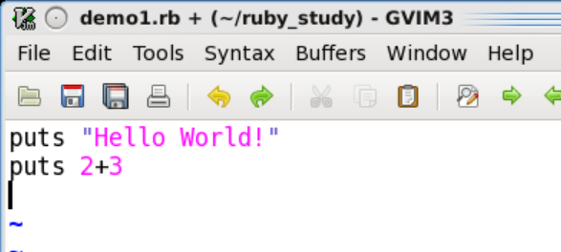
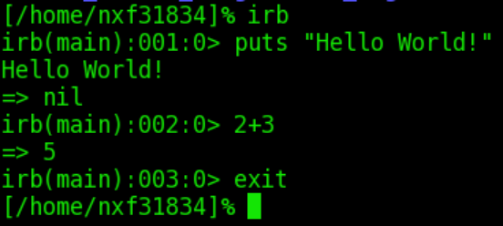
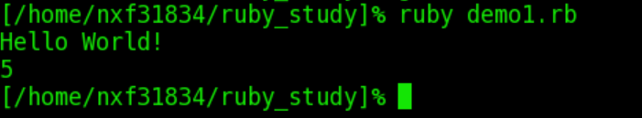
First Program
irb - Interactive Ruby
Create a program file first, then run it.
Easy to experiment

Slide 4
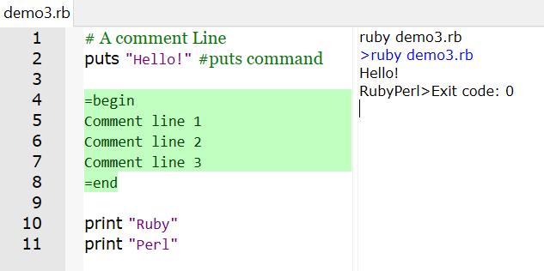
Comments
Single-line comments start with the # character until the end of the line.
Multi-line comments use =begin and =end.
Tips::
puts : Adds a new line to the end
print : Does not add a new line带

Slide 5
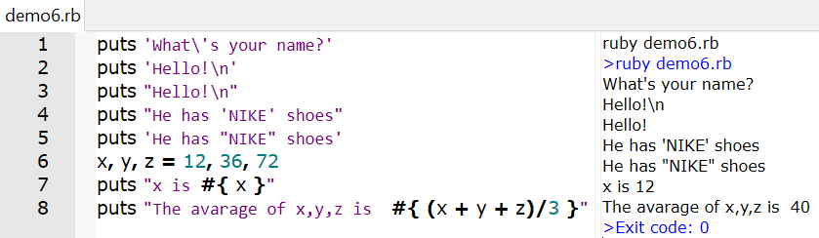
Strings
Divided into single quoted string (') and double quoted string (").
Precede it with a backslash (\) to use ‘ and \ in a single quote string.
Double quoted strings can use more escape characters, such as “\n”.
Use #{} in double quoted strings to reference variables or expressions.

Slide 6
Methods
Method names cannot begin with an uppercase letter.
‘Return’ is used to give the return value in the method. If there is no return statement, the last sentence of the method is the return value.
Syntax ：
No-parameter method:
def my_method
#code
end
Method with default parameters:
def my_method(arg1=value1, arg2=value2)
#code
end
Parametric method:
def my_method(arg1, arg2)
#code
end
Method with variable parameters:
def my_method(*arg1)
#code
end
Eg : demo5.rb:
https://github.com/jfyh5388/ruby_training/blob/master/demo5.rb

Slide 7
Blocks
The block always appears with the method call, and the block's code is always enclosed in braces {}
A block has a name that is always called by a ‘yield’ statement in its same name method.
‘yield’ can pass arguments to the block.
Eg： demo11.rb:
https://github.com/jfyh5388/ruby_training/blob/master/demo11.rb
#define method
def test
yield
end
test{
puts "Hello world“
}
#output : Hello world

Slide 8
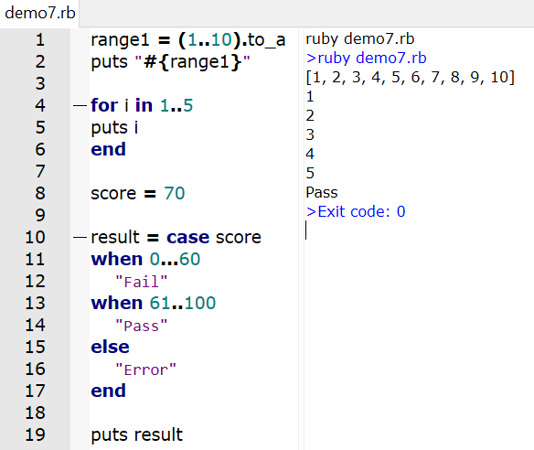
Ranges
Represents a sequence that is created using the ''..'' and ''...'' range operators.
(1..5) #==> 1, 2, 3, 4, 5
(1...5) #==> 1, 2, 3, 4
('a'..'d') #==> 'a', 'b', 'c', ‘d’
Can be used as a condition with ‘case’, ‘for’:

Slide 9
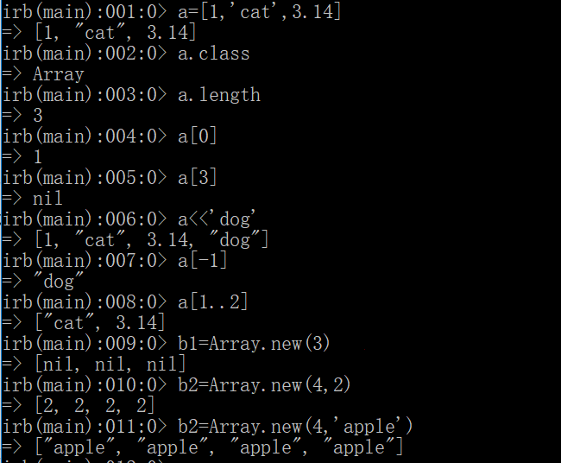
Arrays
The elements in the array do not have to be of the same type.
Index 0 is the first element and -1 is the last element.
a=[2,3,1]
puts a.sort # output: 1 2 3
puts a # output: 2 3 1
puts a.sort! # output: 1 2 3
puts a # output: 1 2 3

Slide 10
Hashes
Hash is similar to an array and is a collection of key-value pairs like "key" => "value".
Hash's index can be almost any object.
The elements of Hash have no specific order.
Syntax ：
hash = {
key1 => value1,
key2 => value2,
key3 => value3
}
hash=Hash.new
hash["a"]=1
Eg：demo4.rb:
https://github.com/jfyh5388/ruby_training/blob/master/demo4.rb

Slide 11
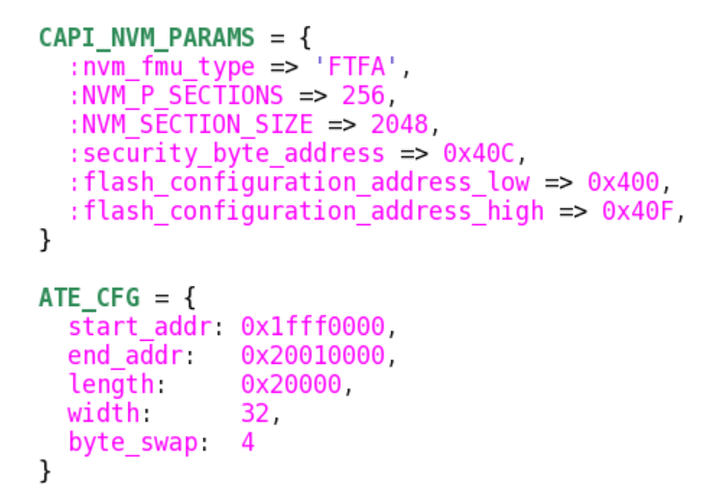
Symbols
Similar to a string, precede the name with a colon. Often used as a key value in the hash.
Syntax : Can also write：
Eg：
price={
:apple=>2,
:pear=>1,
:grape=>3
}
price={
apple:2,
pear:1,
grape:3
}
puts price[:apple] #output : 2

Slide 12
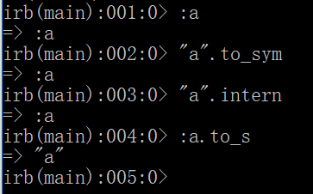
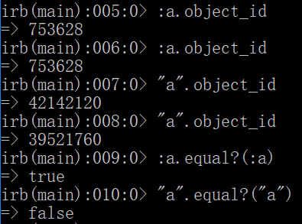
Symbols
Strings and symbols can be converted to each other. String to symbol：to_sym or intern
Symbol to string：to_s
Key differences of symbol and string
The same symbol is the same object, and the same string is not the same object.
object_id:
Return a unique integer corresponding to each object.
Symbols take up less resources than strings

Slide 13
Conditional Execution
If statement:
Unless statement :
x=1
if x >= 2 [then]
puts "x >= 2"
elsif x ==1 [then]
puts “x = 1"
else
puts “x < 0"
end #output : ”x = 1”
x=1
unless x>2 [then]
puts "x <= 2"
else
puts "x > 2"
end #output : ”x <= 2”
if a > 4 then puts “a > 4” end
unless a > 4 puts “a <= 4” end
puts “a > 4” if a > 4
puts “a <= 4” unless a > 4

Slide 14
Conditional Execution
Case statement ：
When the ‘expression’ part of the case is omitted, the expression of the ‘when’ condition part that is the first true is evaluated.
grade=70
case grade
when 80..100 [then]
puts “Top”
when 60..79 [then]
puts “Good”
when 0..59 [then]
puts “Bad”
else
puts “Error”
end #output : ”Good”
foo = false
bar = true
quu = false
case
when foo then puts 'foo is true’
when bar then puts 'bar is true’
when quu then puts 'quu is true’
end
# output "bar is true"

Slide 15
Loop
While statement :
Eg：
Until statement :
while conditional [do]
#code
end
or
while conditional [:]
#code
end
i = 0
num = 5
until i > num do
puts "#{i}"
i += 1
end
#output 0 1 2 3 4 5
i = 0
num = 5
while i < num do
puts “#{i}"
i += 1
end
#output 0 1 2 3 4
i = 0
num = 5
begin
puts "#{i}"
i += 1
end while i < num
#output 0 1 2 3 4
i = 0
num = 5
begin
puts “#{i}"
i +=1
end until i > num
#output 0 1 2 3 4 5

Slide 16
Loop
for statement：
break statement：End all subsequent loops
next statement ：End a loop
for i in 0..5 [do]
puts i
end
#output 0 1 2 3 4 5
for i in 0..5 [do]
if i == 2
break
end
puts i
end
#output 0 1
for i in 0..5 [do]
if i == 2
next
end
puts i
end
#output 0 1 3 4 5

Slide 17
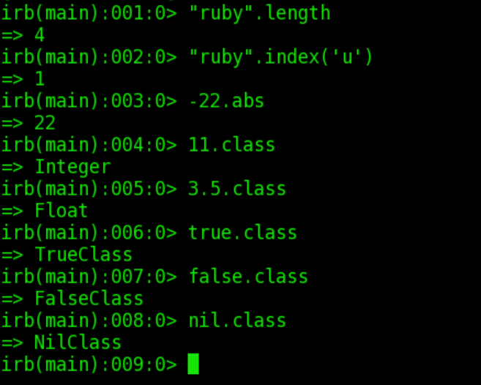
Classes and Objects
Class: is an abstraction of things, such as: car model
Object: is an instance of a class, such as: Mercedes-Benz, bus
Everything is an object.

Slide 18
Class package
Class is a combination of attributes and methods
Class names begin with an uppercase letter
Instantiation：Classname.new
initialize method（private）：
It likes a constructor in other languages. When an object is instantiated, it is called and used to initialize some variables. Instance variables start with @.
# define class
class Shape
#code
end
#define object (Instantiation)
shape1 = Shape.new
class Shape
def initialize(w,h)
@width = w
@height = h
end
def get_width
@width
end
end
shape1 = Shape.new(4,6)
puts shape1.get_width #output 4
Notes:
类的封装就是把对象的属性和操作（或服务）结合为一个独立的整体，并尽可能隐藏对象的内部实现细节。

Slide 19

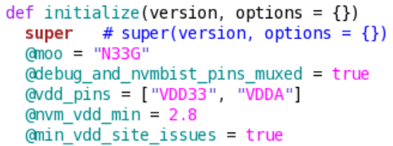
Class inheritance
Inheritance is the derivation of new classes from existing classes.
Use ‘<’ to implement inheritance.
Rectangle : subclass(子类，派生类)
Shape : parent class, base class, super class
The subclass has methods from the parent class, and overrides the same name method.
Super(arg1, arg2...) means to call the same name method of the parent class and pass the parameters.
Eg : demo8.rb:
https://github.com/jfyh5388/ruby_training/blob/master/demo8.rb
class Rectangle < Shape
def area
@width*@height
end
end
rec1 = Rectangle.new(5,6)
puts rec1.area #output : 30
Notes:
继承可以使得一个类拥有另一个类的属性和方法并扩展其功能。

Slide 20
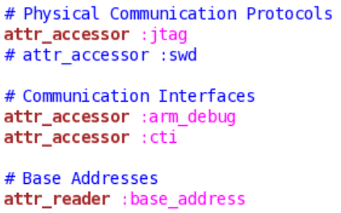
Classes and Objects
Use attr_reader, attr_writer,attr_accessor to read and write the Instance variables.
Name | Function | Example | Equivalent to
attr_reader | read | attr_reader:width | def width @width end
attr_writer | write | attr_writer:width | def width=(width) @width = width end
attr_accessor | read, write | attr_accessor:width | The sum of the above two methods
Eg：demo9.rb:
https://github.com/jfyh5388/ruby_training/blob/master/demo9.rb

Slide 21
Class Variables and Class Methods
A class variable is shared by all instances of a class.
Class variables begin with two @ characters (@@).
Class variables must be initialized in the class definition.
Accessing class variables requires an instance method or a class method.
Eg：demo10.rb:
https://github.com/jfyh5388/ruby_training/blob/master/demo10.rb
define class method：
call syntax：
Classname.methodname
Classname::methodname
Eg：File.delete(“test.rb”)
class Example
def self.methodname()
#code
end
or
def Example.methodname()
#code
end
end
Notes:
1、全局变量，程序运行期间，始终占有那块存储区，所以空间利用率比较低，大量的全局变量，很快就会把内存用光，所以要少用全局变量； 2、全局变量由于每个函数都可以使用，所以任何一个函数的修改，如果修改了全局变量，都有可能影响到其他函数，所以不利于调试。

Slide 22
Variables
Variable: begin with lowercase letters or an underscore. Eg: x, y2, _score
Global variable: begin with $. Eg: $globalCount
Instance variable: begin with @.
Class variable: begin with @@.
Constant: begin with capital letter. Eg: Math::PI

Slide 23
Iterators
An iterator is used to repeat the same thing multiple times. Generally are used to implement loops with arrays, hash tables.
each iterator：
Other iterator：
3.times { puts “hello world”}
1.upto(5){|i| puts i} #output: 1 2 3 4 5
10.downto(5){|i| puts i} #output: 10 9 8 7 6 5
0.step(50,10){|i| puts i} #output: 0 10 20 30 40 50
ary = [1,2,3,4,5]
ary.each do |i|
puts i
end
or
ary.each {|i|
puts i
}
end
prices = {apple:2, pear:4}
prices.each do |key, value|
puts prices[key]
end
#output: 2 4

Slide 24
Modules - Namespaces
The module defines a namespace that solves the problem of conflicting methods with the same name in different files.
A module is like a toolbox that combines methods, constants and so on.
Similar to a class, cannot create an instance or a subclass.
‘require’ is used to include a file. It is similar to the ‘include’ in C language.
Eg：demo_trig.rb:
https://github.com/jfyh5388/ruby_training/blob/master/demo_trig.rb
demo_moral.rb:
https://github.com/jfyh5388/ruby_training/blob/master/demo_moral.rb
demo14.rb:
https://github.com/jfyh5388/ruby_training/blob/master/demo14.rb

Slide 25
Modules - Mixin
When a module is included in a class, the class owns the instance methods in the module. The module simulates the functionality of the parent class.
When multiple modules are included, the functionality of multiple inheritance is simulated. This is called mixin in ruby.
Before including, we need to load the file with require.
Eg：demo15.rb:
https://github.com/jfyh5388/ruby_training/blob/master/demo15.rb
m1.rb
m2.rb
example.rb
module M1
def method1
end
end
module M2
def method2
end
end
require ‘m1’ #文件名
require ‘m2’
class Example
include M1 #模块名
include M2
end
ex1 = Example.new
ex1.method1
ex1.method2

Slide 26
Debug
pry-byebug gem:https://rubygems.org/gems/pry-byebug/versions/3.4.0?locale=zh-CN
Installl pry-byebug : gem install pry-byebug (or add “gem ‘pry-byebug’”into the Gemfile, and run ‘bundle install’ command)。
Add “require ‘pry’” at the beginning of the file.
Add “binding.pry” statement where you need a breakpoint
Run into the breakpoint, use the next, step, continue, whereami and other statements to debug.
Eg：demo15.rb:
https://github.com/jfyh5388/ruby_training/blob/master/demo15.rb

